Slide 1
Agile Foundations with Scrum
Session 4: Product Backlog Building

Slide 2
Manifesto for Agile Software Development
We are uncovering better ways of developing software by doing it and helping others do it.
Through this work we have come to value:
Individuals and interactions over processes and tools Working software over comprehensive documentation Customer collaboration over contract negotiation Responding to change over following a plan
That is, while there is value in the items on the right, we value the items on the left more.
Notes:
What is Agile is a question that gets asked a lot.
Agile is a buzz work that gets thrown around a lot.
At the core of all things agile is the Agile Manifesto.
If a practice, process, or tool can demonstrate that it holds true to all four of the agile values, we can confidently call it agile.

Slide 3
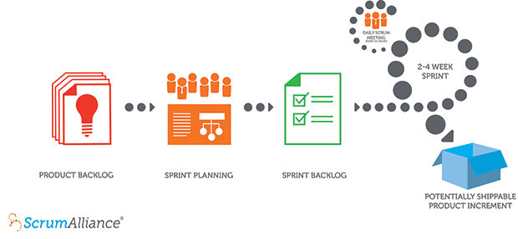
How Scrum Works
We Are Here
Notes:
A product owner creates a prioritized wish list called a product backlog.
During sprint planning, the team pulls a small chunk from the top of that wish list, a sprint backlog, and decides how to implement those pieces.
The team has a certain amount of time — a sprint (usually two to four weeks) — to complete its work, but it meets each day to assess its progress (daily Scrum).
Along the way, the ScrumMaster keeps the team focused on its goal.
At the end of the sprint, the work should be potentially shippable: ready to hand to a customer, put on a store shelf, or show to a stakeholder.
The sprint ends with a sprint review and retrospective.
As the next sprint begins, the team chooses another chunk of the product backlog and begins working again.

Slide 4
Scrum Terms
Time box – time window or time limit. Described in terms of duration. E.g: 2 hour time box.
Sprint – a time box during which the team will build, test, and deliver to the product owner a unit of work they have identified from the Product Backlog.
Release – a group of items from the product backlog that will be delivered to the end user together. A release can be built over multiple sprints.
User Story – a use case that describes product functionality from a user or actor perspective.
Product Backlog – a prioritized wish list of features, functionality, or use cases.
Sprint Backlog – the list of user stories and/or tasks that will be delivered by the development team by the end of the Sprint.
Sprint Goal – a simple statement of purpose for the team to achieve by the end of the Sprint.
Velocity – the average amount of work delivered in one Sprint by the team.
Story Point – a relative unit of measure for level of effort based on complexity.
Baseline Story – the story against which other stories are compared to determine their story point value.

Slide 5
The Exercise
Review the Handout

Slide 6
Before you write requirements…
How Are We Prioritizing This Work?
Who are our users? Does this work impact a business processes?
Is one of these more important than the others?
What is the Business Value of This Work?
Why is this work important to our organization and the business we do?
How does this work deliver value?
What is the Value to the Customer?
Why do our customers need or want this?
Notes:
The Scrum Master’s authority is in rules enforcement, not in timelines, scope control, or quality control. The Scrum Master leads from the back of the room.

Slide 7
Who Are Your Users?
Are they employees of the Knights? – Internal Users.
Are they council members? – External Users.
Be specific:
User 1: Council Financial Secretary
User 2: Member Records Clerk

Slide 8
Anatomy of a Product Backlog
Business and User Value
Product Backlog Items (user stories, features, etc.) with clear business and user value.

Slide 9
Business Value and User Value
The value provided to users (both internal and external) may not be the same as the value provided to the organization.
Business value is usually delivered through changing or supporting a business process.
User value is usually derived through interaction with a product.
Notes:
Transparency and honest are key to a successful team.
A team must be given time to go through the stages of team formation:
Forming – the team moves at a slow pace as they get to know each other. This stage often has confusion and uncertainty.
Storming – often has a good deal of conflict as folks hash out roles and accountability
Norming – the team begins to hit their stride, communicate well, and build trust. Conflicts are negotiated constructively.
Performing – the team has hit their stride and begin to deliver value, communicate efficiently, and collaborate as a habit.
Transforming/Adjourning – As an increment is closed, or a project comes to an end, the team composition may be adjusted. This will put the team back into the forming stage and the cycle begins again.

Slide 10
Product Road Map
What are our release deadlines?
What is the MVP (minimum viable product) for each deadline?

Slide 11
1:50 PM - Retrospective
How does the burn down look?
4 Quadrants Exercise:
On a sticky note write (1 item per sticky):
What went well or not well; suggestions and shout-outs
Place on the appropriate quadrant.

